Slide 1
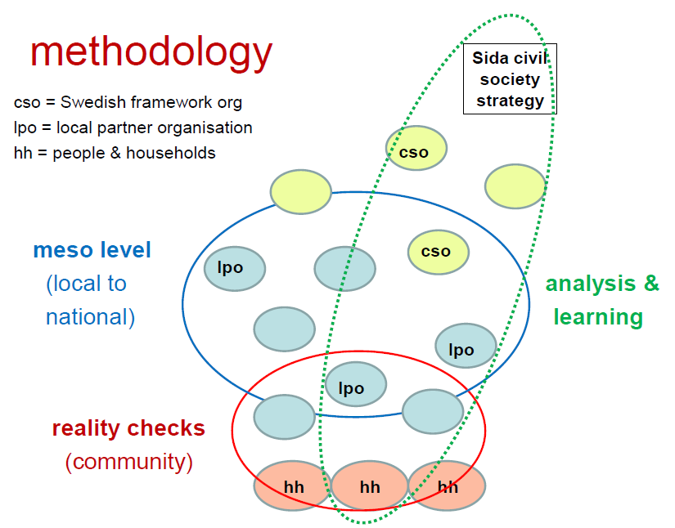
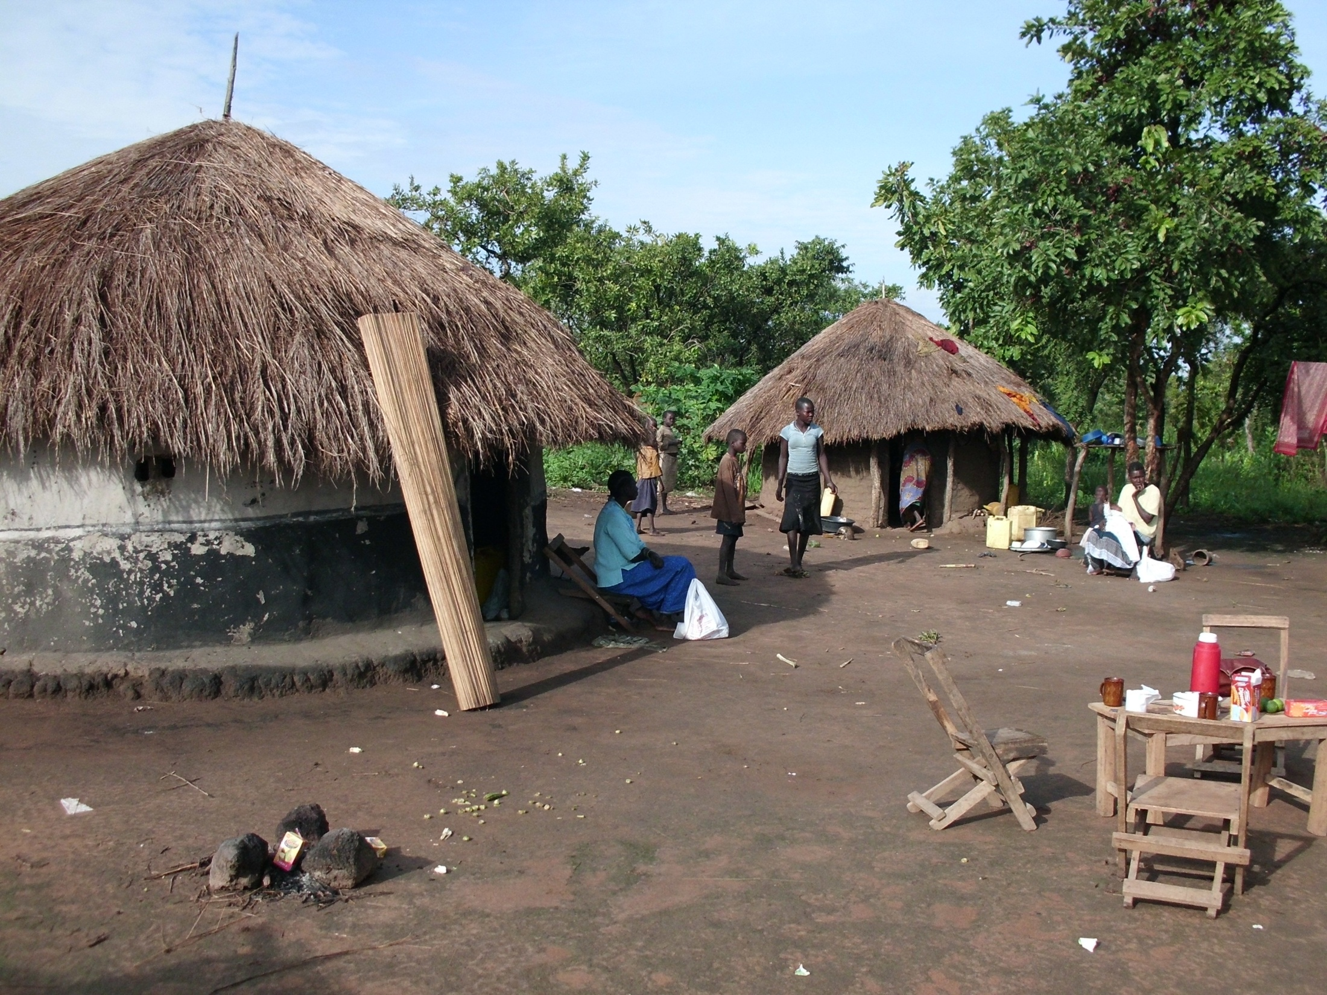
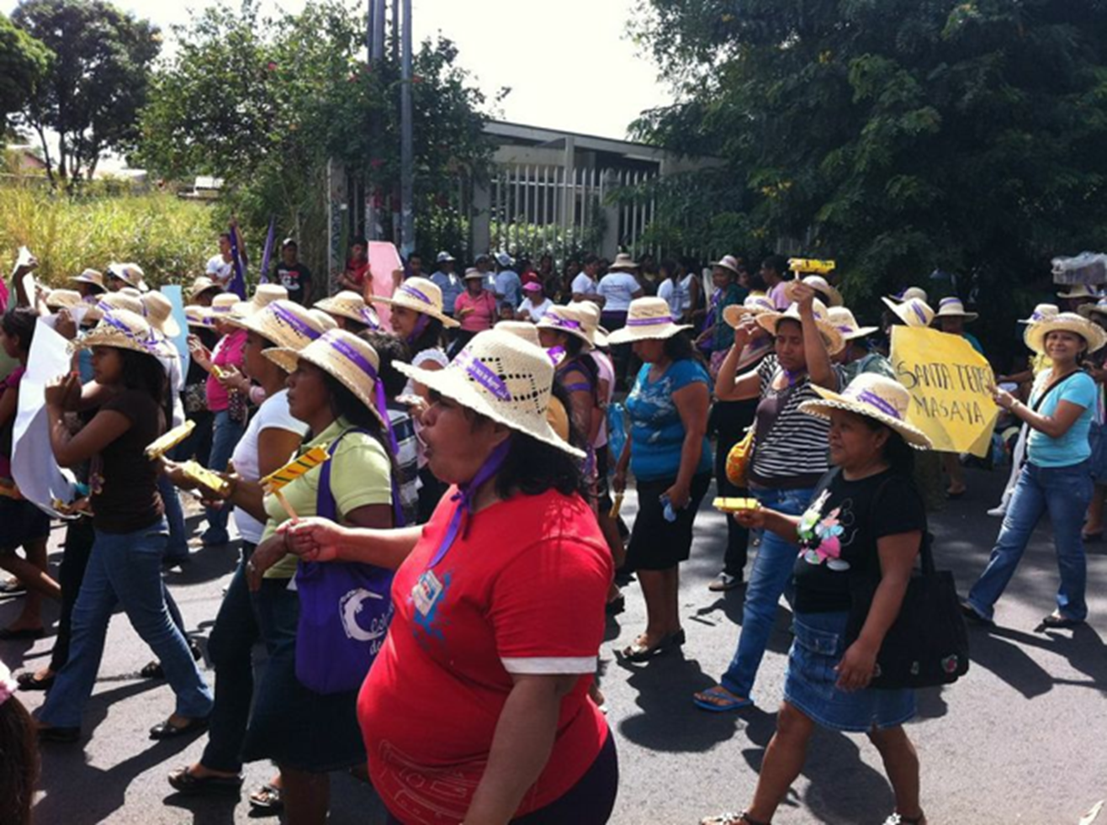

Evaluation of Sida’s support to civil society via Swedish CSOs – based on realities of people living in poverty
Focus
Is Sida’s civil society strategy (via CSOs) aligned, relevant and feasible?
The study seeks to understand...
The realities of people living in poverty and marginalisation, and their perceptions of what is changing in the enabling conditions needed to improve their lives.
What the human rights based approach and its four principles of participation, transparency, accountability and non-discrimination mean to people living in poverty.
The theories of change and strategies of Swedish CSOs and their local partners, and how they understand and pursue the human rights based approach.
The plausible contributions of Swedish CSOs and their partners to creating changes in enabling conditions, and of CSO capacity development efforts.
The relevance, alignment and feasibility of the theories of change, strategies and interventions of the Swedish CSOs and their partners
Purpose
“to find out if, how and why/why not the support to civil society actors in developing countries via Swedish CSOs has contributed to the overall objectives of the support by creating conditions to enable poor and discriminated people to improve their living conditions and quality of life.”
Scope
3 Countries (Nicaragua, Pakistan, Uganda)
9 research sites & themes (3 per country)
16 Swedish CSOs and their partners
Research Consortium
Swedish Institute for Public Administration (SIPU International)
Institute of Development Studies (IDS)
International Organisation Development (IOD PARC)
Methodology
Reality Check Approach (RCA) in which researchers immerse themselves in the daily realities and households of people living in poverty, in order to understand their lives and perspectives.
combined with
“Meso-level” and organizational inquiries to document the theories of change and practices of civil society and other actors at the local, national and international levels
and
Learning and validation events with Swedish CSOs, their partners and other stakeholders
https://sidacivilsocietyeval.wordpress.com/

